Slide 1
Project Report 5
0111279 Annie Chen

Slide 2
目前的進度
雙系統安裝完成(Window 10 & Fedora 23)
安裝自己build的kernel(4.5.1)在Fedora 23
安裝core temp 及 real temp 於 Window 10
安裝lm_sensors 及 psensor 於 Fedora 23
閱讀 intel i5 temperature guide

Slide 3
Install FEDORA 23 and linux kernel 4.5.1
FEDORA 23 :
https://www.youtube.com/watch?v=gOP_FtP1e9U
Linux kernel 4.5.1 :
https://www.youtube.com/watch?v=0hyr6TiYKDI

Slide 4
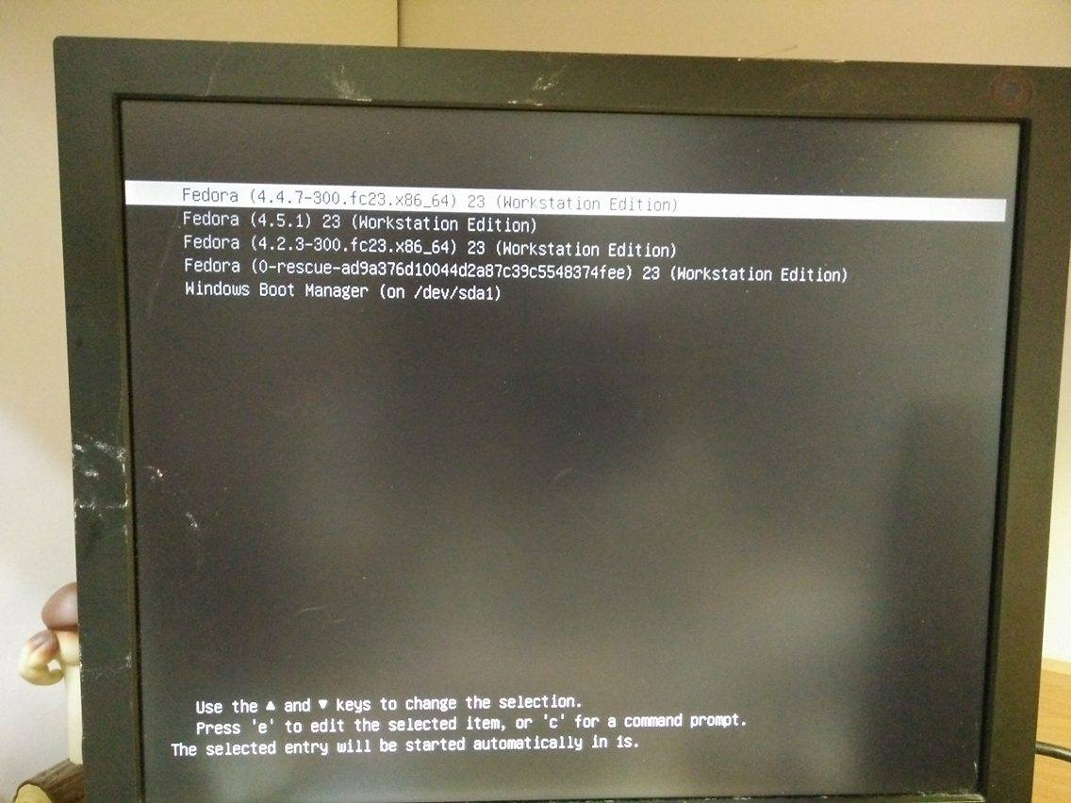

Slide 5
temperature monitoring program
Window 10 :
- Core temp
- Real temp
Fedora 23 :
- lm_sensors :
- sensors-detect
- sensors
- psensor

Slide 6
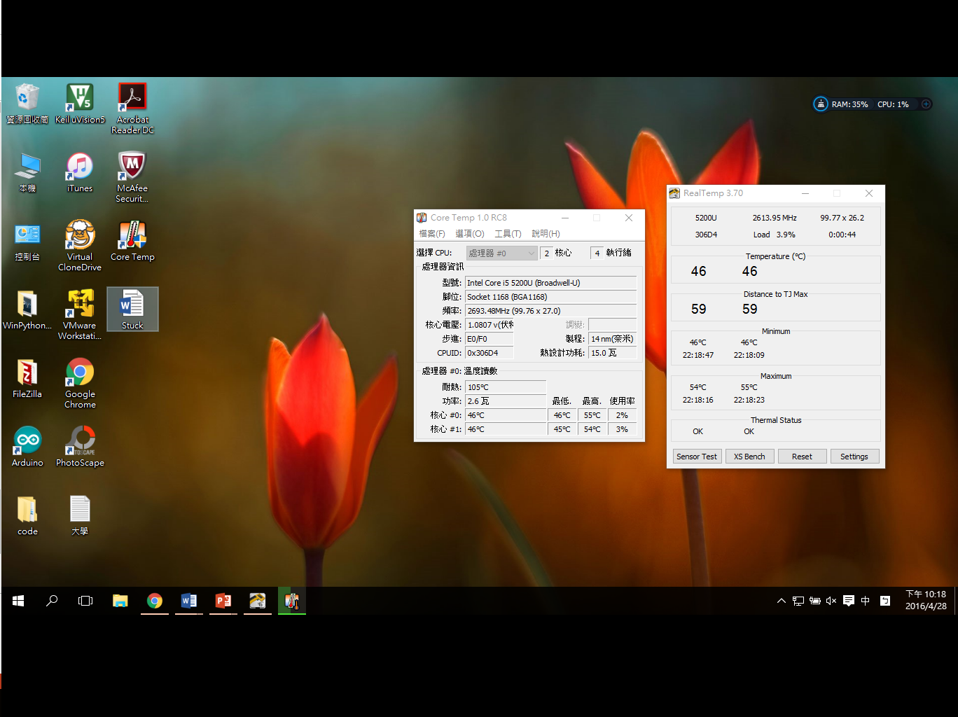

Slide 7
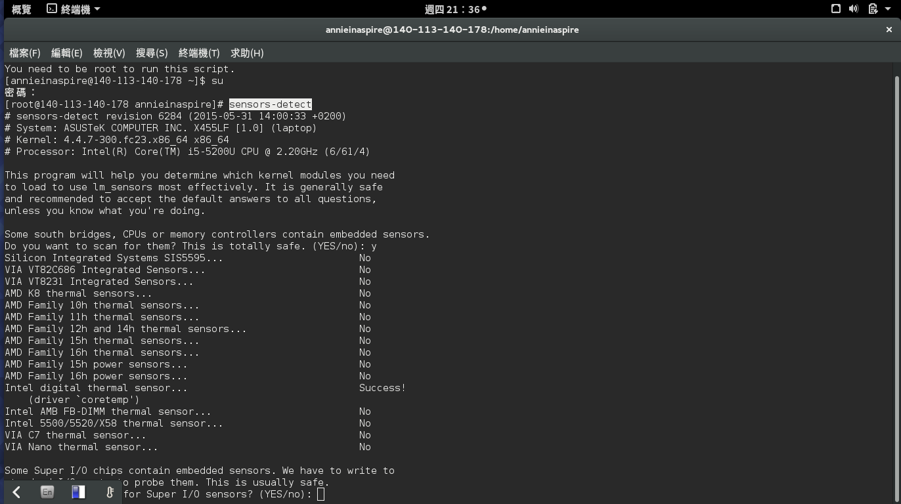

Slide 8
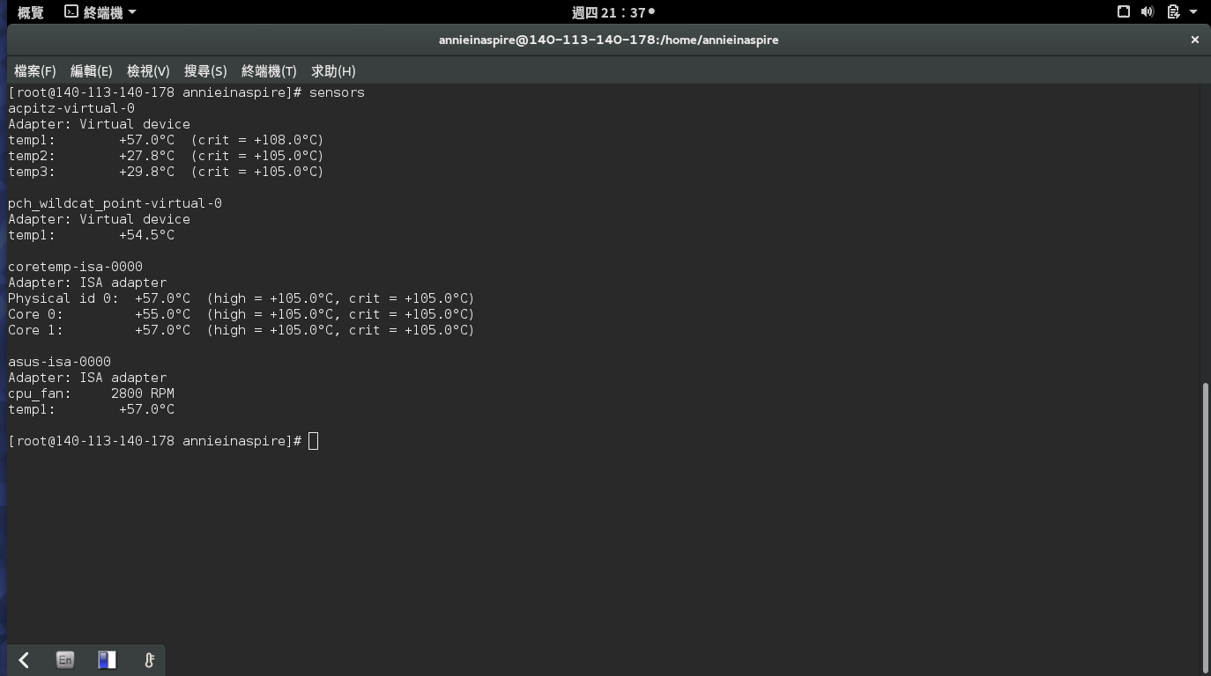

Slide 9
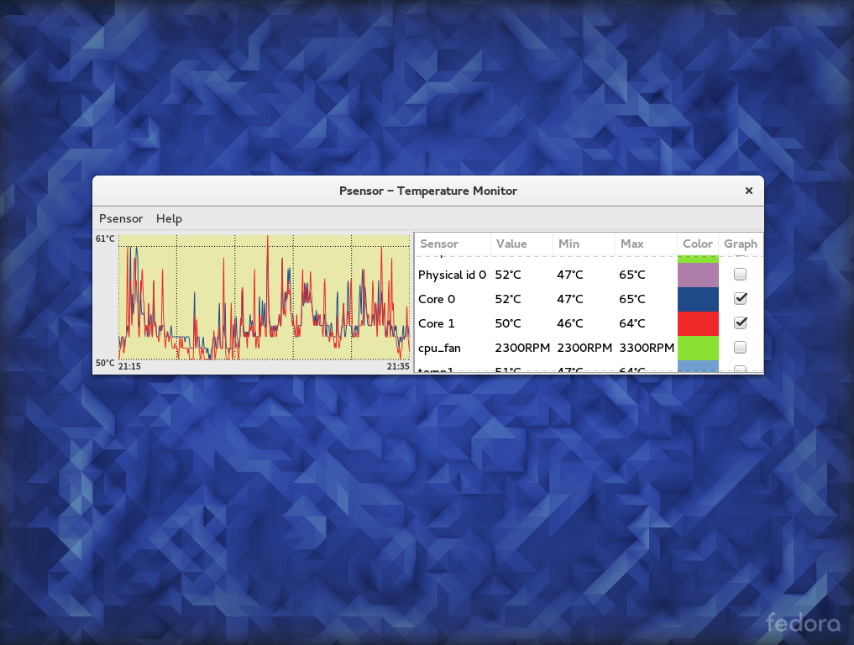

Slide 10
intel i5 temperature guide
主要是看以下三個網站 :
1. Temperature-Related Frequently Asked Questions for Desktop and Mobile
Intel® Processors
(http://www.intel.com/content/www/us/en/support/processors/000005597.html)
2. Intel Temperature Guide
(http://www.tomshardware.com/forum/id-1800828/intel-temperature-guide.html)
3. Guide to Understanding Intel Temperatures
(http://www.techreaction.net/2009/10/14/guide-to-understanding-intel-temperatures/)

Slide 11
Some terminologies
T_{case} :
Temperature of T_{case} sensor which was measured by a thermocouple embaded Temin the center of the integrated heat spreader
T_{case} MAX :
Maximum temperature that should be reached by T_{case} sensor
T_{junction} :
It is synonymous to “core temperature” and is calculated by the formula “ T_{junction} = T_{junction} MAX – DTS outputs ”.
T_{junction} MAX :
Maximum temperature the cores can reach before the thermal throttling is activated.

Slide 12
Testing for core temperature
Only three relevant elements :
Ambient temperature
Core temperature at steady-state 100% workload
Core temperature at dead idle
Testing method when Core temperature at steady-state 100% workload :
Run Prime95 v26.6 Small FFT's for 10 minutes, then use your thermometer to measure Ambient. Use Core Temp to measure your Core temperatures.
Testing method when Core temperature at dead idle :
Allow your rig to "settle" for 10 minutes, then use your thermometer to measure Ambient. Use Core Temp to measure your Core temperatures.

Slide 13
Some important information
• Standard Ambient temperature is 22C. • Ambient affects all computer temperatures. • No temperatures can be less than or equal to Ambient. • As Ambient increases, thermal headroom decreases. • BIOS or CPU temperature may not be accurate. • Package temperature is the hottest Core. (?) • Core temperature is the standard for thermal measurement. • Core temperatures respond instantly to changes in load. • 80C sustained Core temperature is too hot. • Core temperatures in the mid 70's are safe. • Prime95 v26.6 Small FFT's is the standard for thermal testing. • Deviations between highest and lowest Cores may be 10C. • Core temperature sensors are more accurate at high temperatures.
(1 degree change in actual core temperature doesn’t mean the DTS output change by 1.)
• Idle temperatures may not be accurate. • Sensors can be tested with Real Temp.

